Slide 1
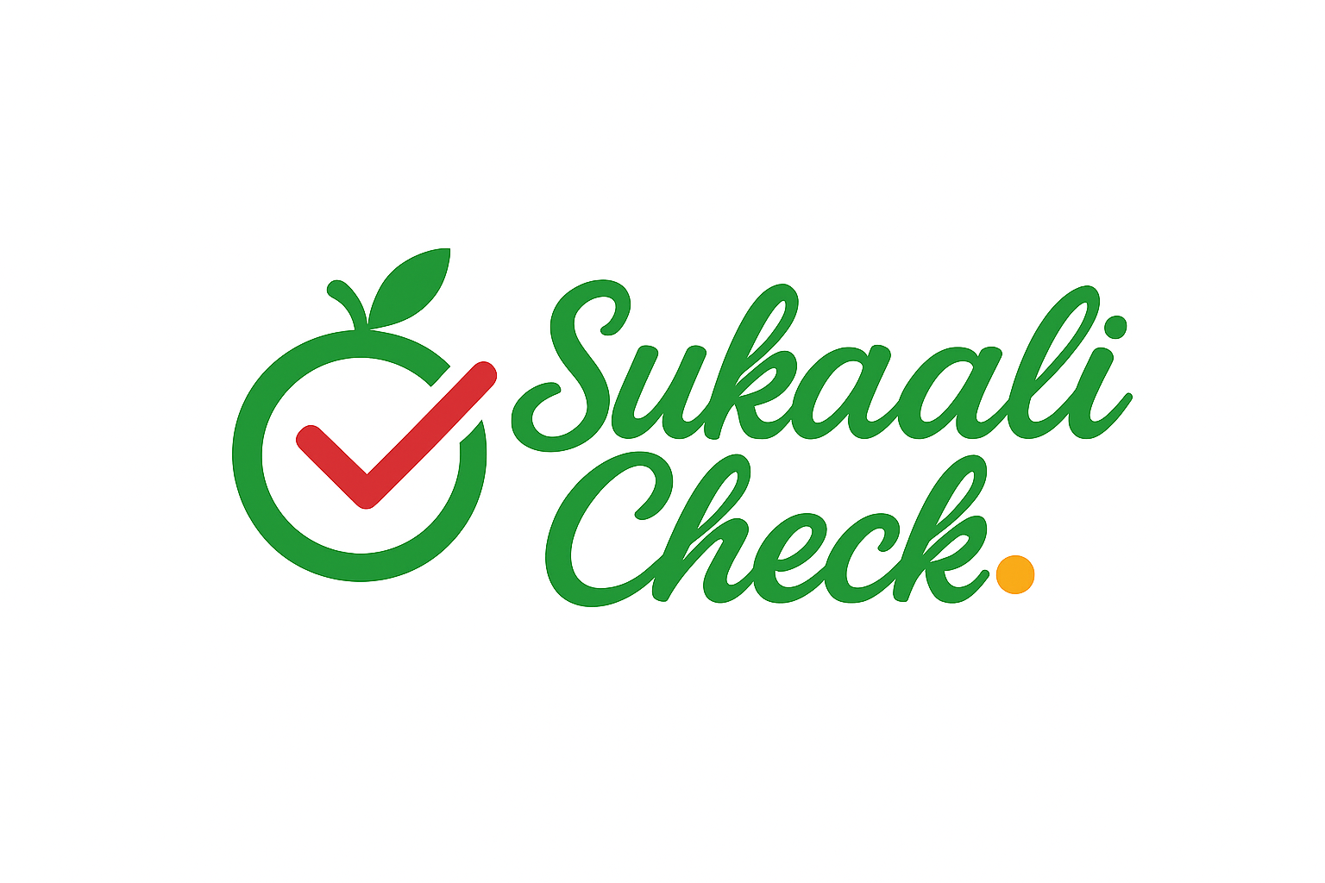
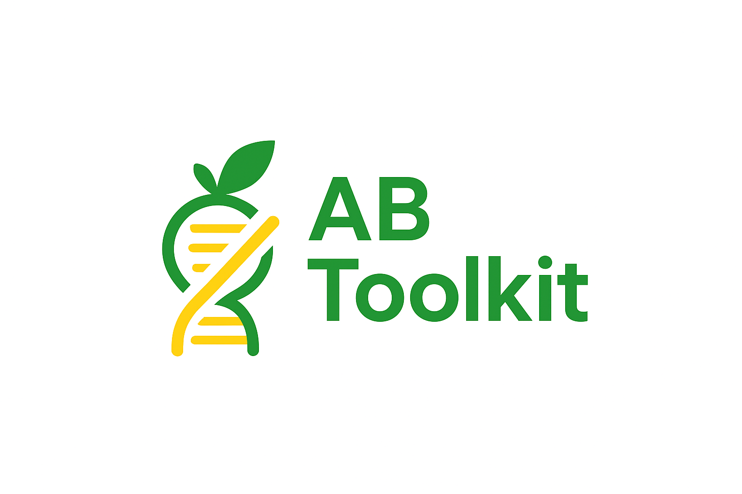
AI-DRIVEN DIABETES RISK PREDICTOR

Slide 2
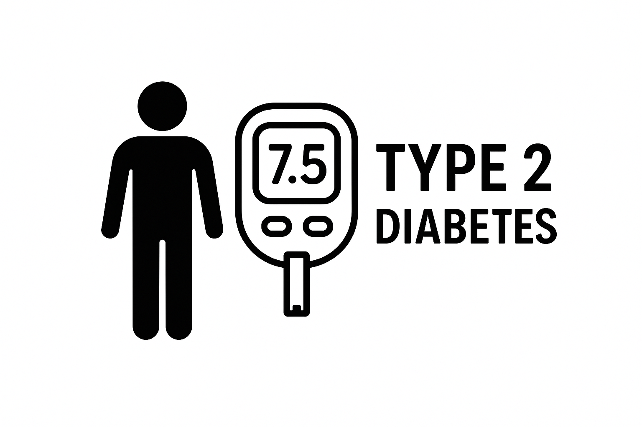
The Problem
24,600,000
Africans with Diabetes
369,100
Diabetic Ugandans
Because...
Low community awareness
Rising obesity
Late screening

Slide 3

Why It Matters
Prediabetes is reversible
with early detection.
Late treatment is 10x more expensive.
Diabetes clinics have data available.
Mobile phone penetration is high — big opportunity.

Slide 4
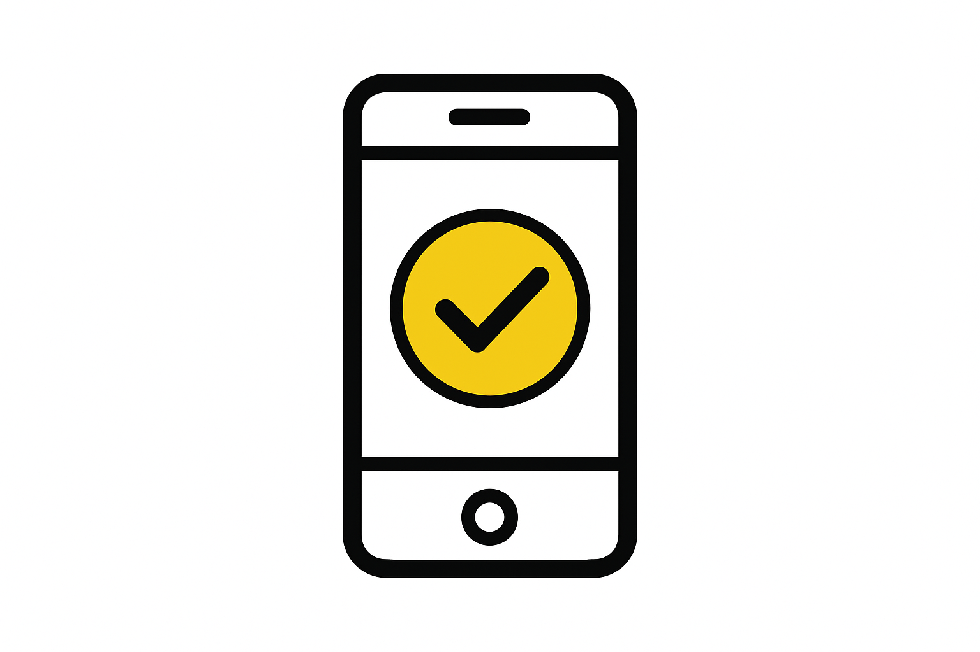

AI Solution
Mobile ML app predicting diabetes risk.
Metadata, lifestyle, vitals ,BG test(if available).
Early, accessible, affordable screening
Instant risk score + recommendations

Slide 5
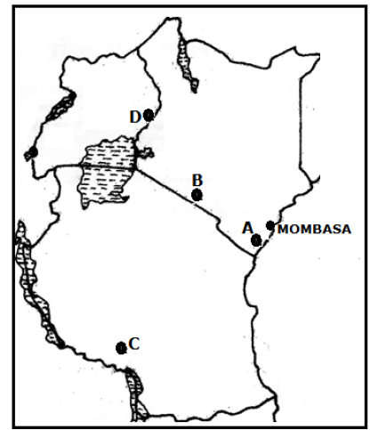
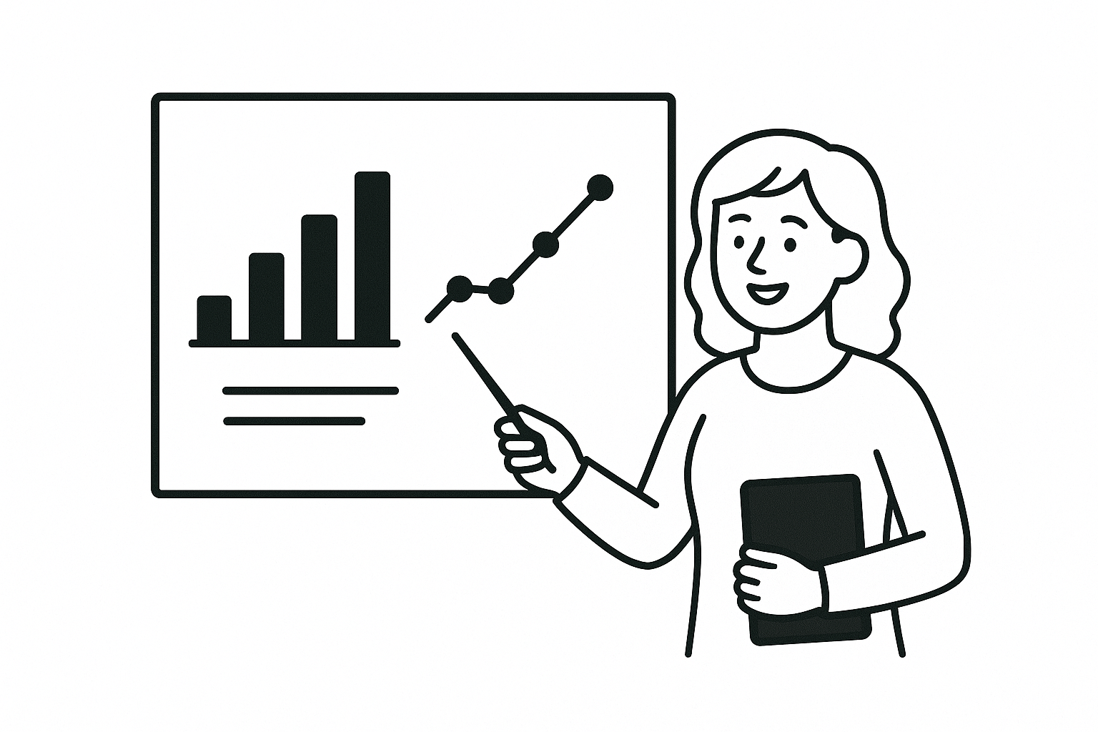
The ML Model
Locally trained for Uganda/EA.
Models: XGBoost(0.90), Random Forest(0.92)
Dataset: age, sex, BMI, activity, family history, diet, hypertension, Blood glucose(if tested).

Slide 6
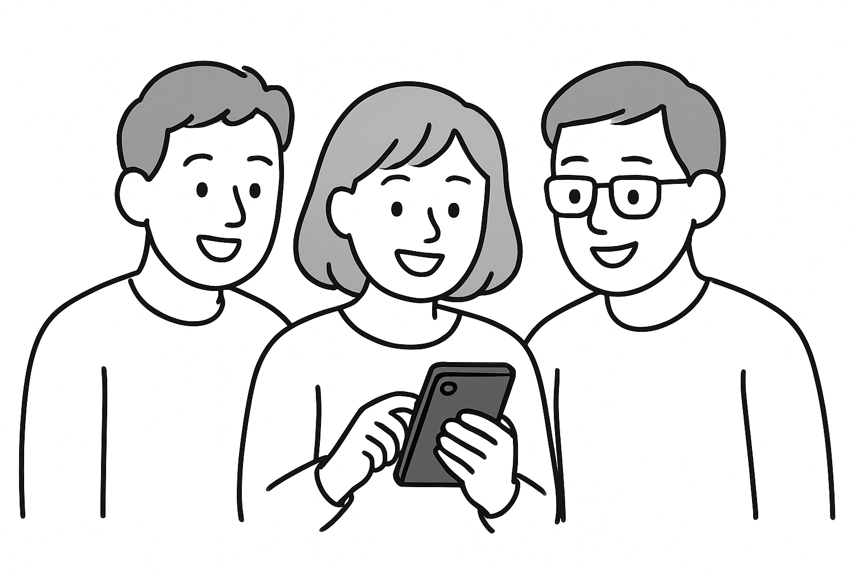
Key Features
Self-assessment (5–7 min).
Offline capability.
Local language support.
CHW dashboard.
Privacy-first design(no names).

Slide 7
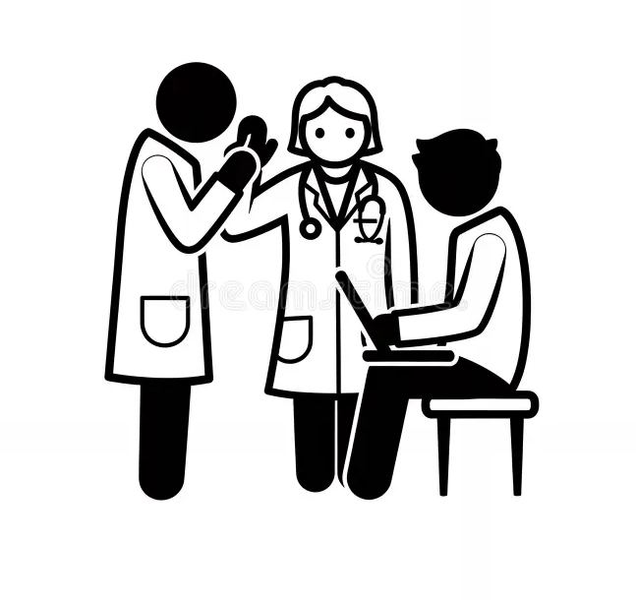
User Personas
Community members: early guidance.
Community Health Workers: faster screening.
Clinics: triage support.
NGOs: risk mapping.

Slide 8

Impact Goals
Screen 300–500 people.
Identify 50–100 high-risk individuals.
Strengthen CHW NCD capacity.
Create baseline dataset for ML improvement.

Slide 9




Pilot Plan (3 Months)
MVP Finalization (Weeks 1–2).
Deployment to 1 district/2 health centers (Weeks 3–8).
Evaluate, refine model, report (Weeks 9–12).

Slide 10
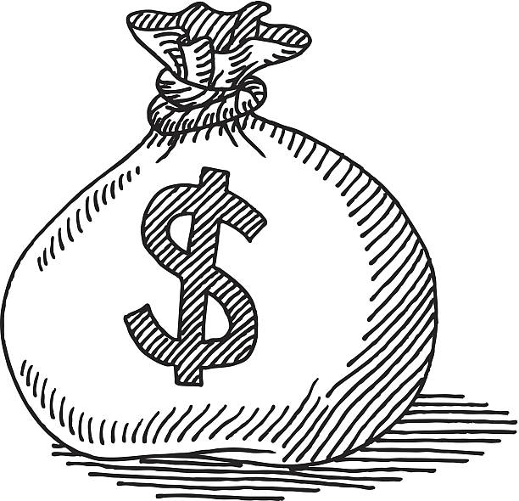

Funding Ask — $4,000
App Development & Backend – $1,500.
Field Pilot – $1,200.
ML Refinement – $600.
Monitoring & Reporting – $400.
Contingency – $300.

Slide 11
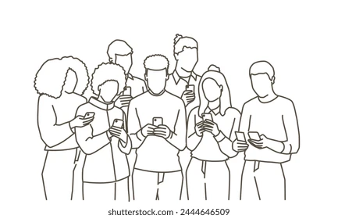
Sustainability & Scale
NGO partnerships.
Government integration.
Clinic subscription model.
Insurance and employer wellness programs.
Long-term: multi-NCD Prediction platform

Slide 12

Why Us
Strong ML expertise
Deep understanding of local health context
Pilot-ready Product
High-impact results for a low-budget pilot

Slide 13
The Team
Hellen Nakabuye (MSc)– Team Lead
Ainebyoona Derrick (BSc)– Software Advisor
Dickson Aruhomukama(MSc) – HeathTech Advisor

